Slide 1
LL(1) Parser
Pushkar Pandey-01FB14ECS170

Slide 2
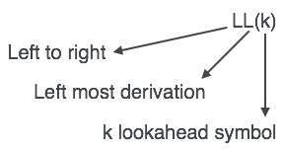
Description of Project
LL parser is a top-down parser for a subset of context-free languages.
It parses the input from Left to right, performing Leftmost derivation of the sentence.
An LL parser is called an LL(k) parser if it uses k tokens of lookahead when parsing a sentence.

Slide 3
Table-driven predictive parser
Automatically compute PREDICT table from grammar
PREDICT(nonterminal,input-symbol) action, e.g. which rhs or error
A predictive parser can only be built for an LL(1) grammar. A grammar is not LL(1) if it is: 1. Left recursive, or 2. Not left factored.

Slide 4
Algorithm :
push S$ /* S is start symbol */ while Stack not empty X := pop(Stack) a := peek at next input “token” /* EOF => $ */ if X is terminal or $ If X==a, read token a else abort; else look at PREDICT(X, a) /* X is nonterminal*/ Empty : abort rule X → α : push α If not at end of input, Abort else Accept
Notation: T = Set of Terminals (Tokens) N = Set of Nonterminals $ = End-of-file character (T-like, but not in N ∪ T)
To build the table, we must must compute FIRST and FOLLOW sets for the grammar.

Slide 5
FIRST Sets
FIRST(α) is the set of terminals that begin the strings derivable from α
If α can derive ǫ, then ǫ is in FIRST(α).
For calculating first of all Non-Terminals, 1. Scan all non-terminals one by one 2. For all non-terminals, start scanning its grammar (rhs of -->) 3. If a terminal symbol or ^ (epsilon) is found, put that terminal as first of corresponding non-terminal in first list(fi). 4. Else, if non-terminal is found, find first of that non-terminal by calling First() function again. 5. Add first in first list (fi)

Slide 6
FOLLOW Sets
For constructing follow set, we need first set, so, Firstset=first(g,term,nterm) is executed.
For first Non-Terminal, follow has “$” always included.
Then to find the follow of all Non-Terminal, we’ll scan the RHS of every grammar. If the non-terminal is found, 1. follow of Non-terminal is first of symbol after it. 2. if first of next symbol is epsilon(^), then follow is first of next-to-next symbol. 3. if there is no symbol after Non-Terminal, follow is follow of symbol in LHS of -->

Slide 7
Parse Table
For creating parse table, we’ll create a table (PPT here) of rows having Terminals including “$” and columns having Non-Terminals.
Under every Terminal, we’ll place production if the first and Terminal symbol matches.
If the production has ^(epsilon), like T-->^, we’ll place the production under the follow symbol also.
And in the empty spaces, we’ll fill “error”.
So, in the end we’ll have PPT which has the parse table values.

Slide 8
String Parsing
Input String entered by the user will be read and stored in Intput[] list.
We’ll create a stack which has $ at the bottom and at top it has S (start symbol).
Now, one by one input character are read from the input string and according to the character, decision is made using parse table of which production to push in stack after popping the top symbol.
Now, after top of stack is matched with input character, pop stack and increment the pointer of Input[].
Repeat this process of pushing and popping.
In the final step, if $-$ is matched(of stack and input string), the String is ACCEPTED.
If not, ERROR. Input string is NOT ACCEPTED.

Slide 9
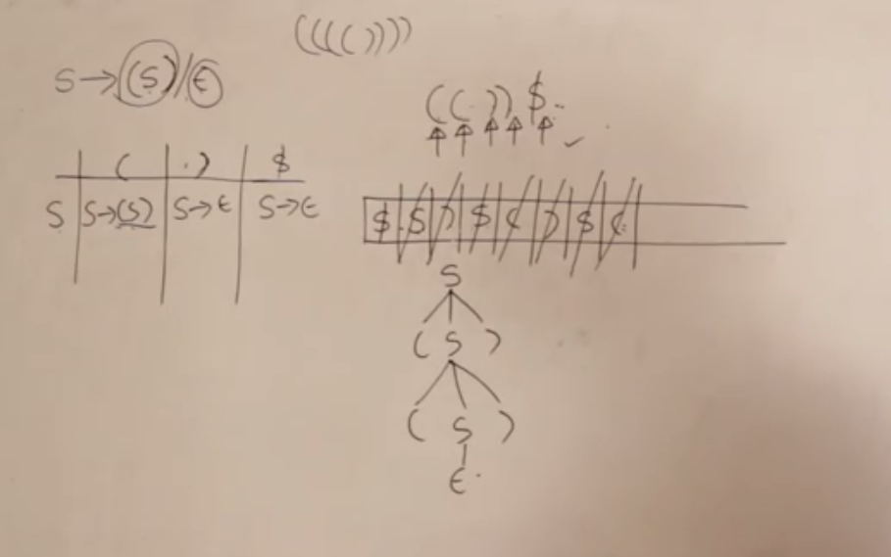

Slide 10
Thank You !

